Slide 1
Python
Sentencia match - Ciclos

Slide 2
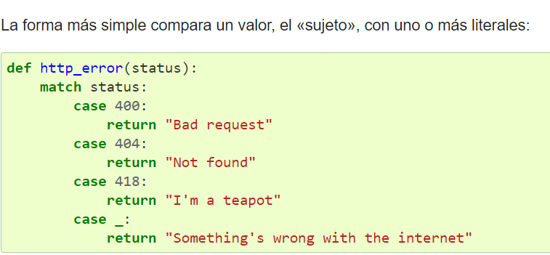
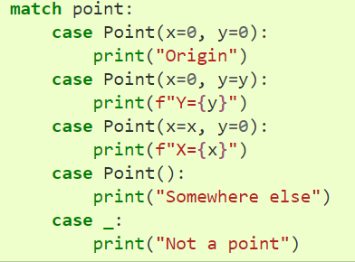
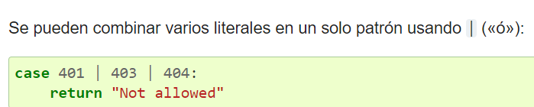
Sentencia match

Slide 3
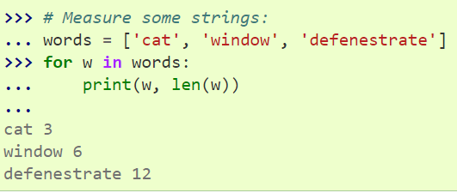
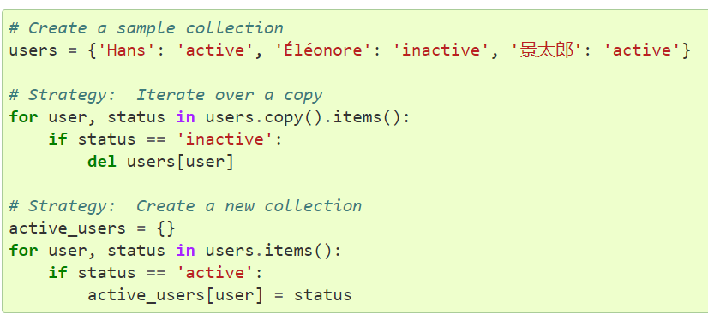
La sentencia for

Slide 4
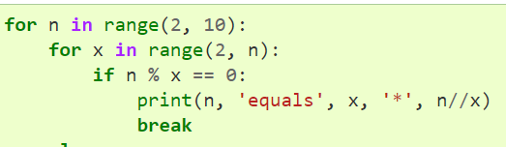
La sentencia for Break - Continue

Slide 5
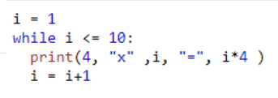
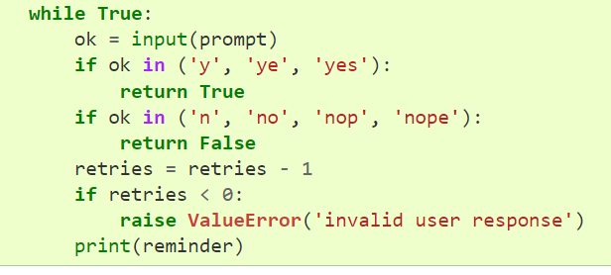
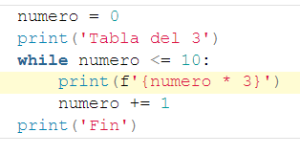
La sentencia while

Slide 6
Links de interés
https://docs.python.org/es/3/tutorial/controlflow.html#for-statements
https://tutorial.recursospython.com/bucles/#:~:text=Los%20bucles%20son%20otra%20herramienta,de%20bucle%3A%20while%20y%20for.
https://j2logo.com/bucle-for-en-python/
https://medium.com/@hgodinez89/operaciones-sobre-listas-en-python-c19853a9d07b
https://www.mclibre.org/consultar/python/lecciones/python-for.html
https://pythondiario.com/2016/05/cuenta-regresiva321-iteracionesfor.html

